Slide 1
Lecture Set No. 1 Winter 2011
ECE 162B
Fundamentals of Solid State Physics
Class Introduction and Crystal Structures”
Prof. Steven DenBaars
ECE and Materials Depts
Solid State Lighting & Display Center
University of California Santa Barbara, USA

Slide 2
Required Text:
Electrical Properties of Materials, L. Solymar and D. Walsh, Oxford University Press, 8th Edition, 2004, ISBN 13-978-0-19-926793-4
Suggested Text (Some Course notes will be derived from this)
Kittell Intro. To Solid State Physics, 7th Edition
Course Prerequisites:
ECE 162A
Homework:
Will be assigned approximately weekly and due the following week at the start of class. Late homework up to 1 day late will receive 20% reduction in grade. Assignments handed in more than 1 day after due date will not be graded.
Grade distribution:
Homework 30%
Midterm 30%
Final 40%

Slide 3
Covered Material: Crystal lattices and the structure of solids, with emphasis on semiconductors. Lattice vibrations. Electronic states and energy bands. Electrical and thermal conduction. Dielectric and optical properties. Semiconductors: intrinsic, extrinsic doping, diffusion, P-N junctions and diode behavior.
OUTLINE
Crystal Structure-Chapters 1 in Kittel (Handout)
Crystal Bonding-Chapter 5 in Solymar and Walsh
Electronic Structure, Free Electron Theory-Chapter 6 in Solymar and Walsh
Band Theory-Chapter 7 in Solymar and Walsh
Semiconductors-Chapter 8 and Chpter 9 in Solymar and Walsh
-Handouts on Measurements & Applications

Slide 4
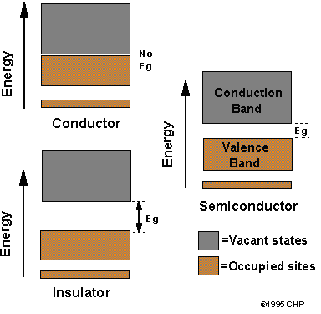
3 Different Solid State Materials
(metals,insulators, semiconductor)
WBS have
E_{G} larger
than 2.5eV

Slide 5
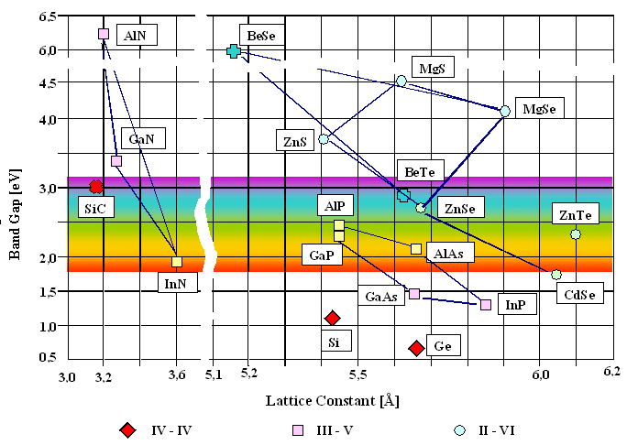
Semiconductor Bandgaps
diamond
WBS
ZnO

Slide 6
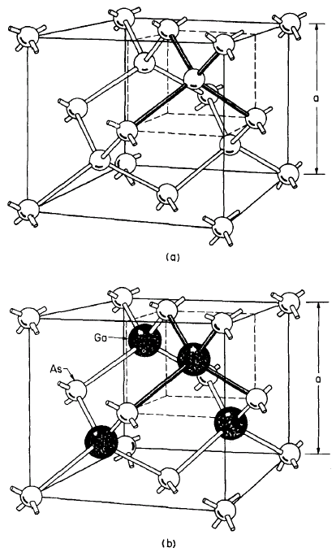
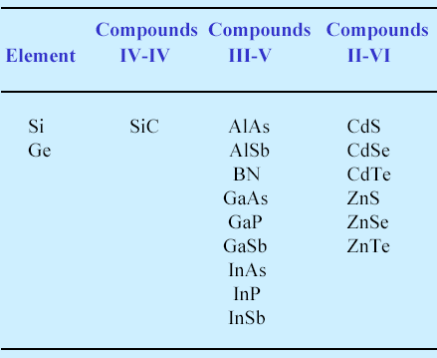
Semiconductors I
Diamond
Structure
Zincblende
Structure
Diamond
Structure
Zincblende
Structure

Slide 7
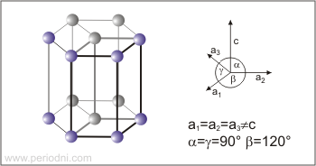
Semiconductors II
Hexagonal Close Pack (HCP)
)

Slide 8
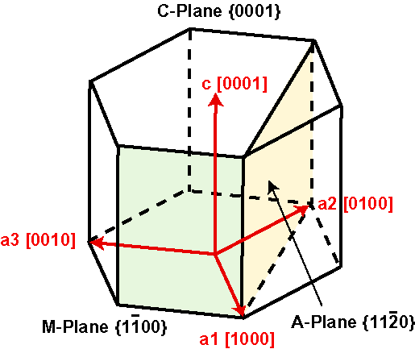
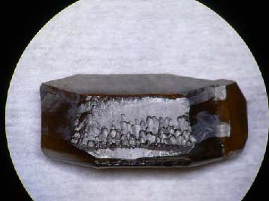
GaN Crystal
(UCSB Bulk X’Tal Lab)

Slide 9
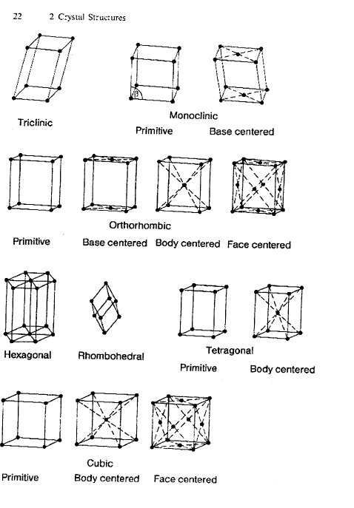

Slide 10
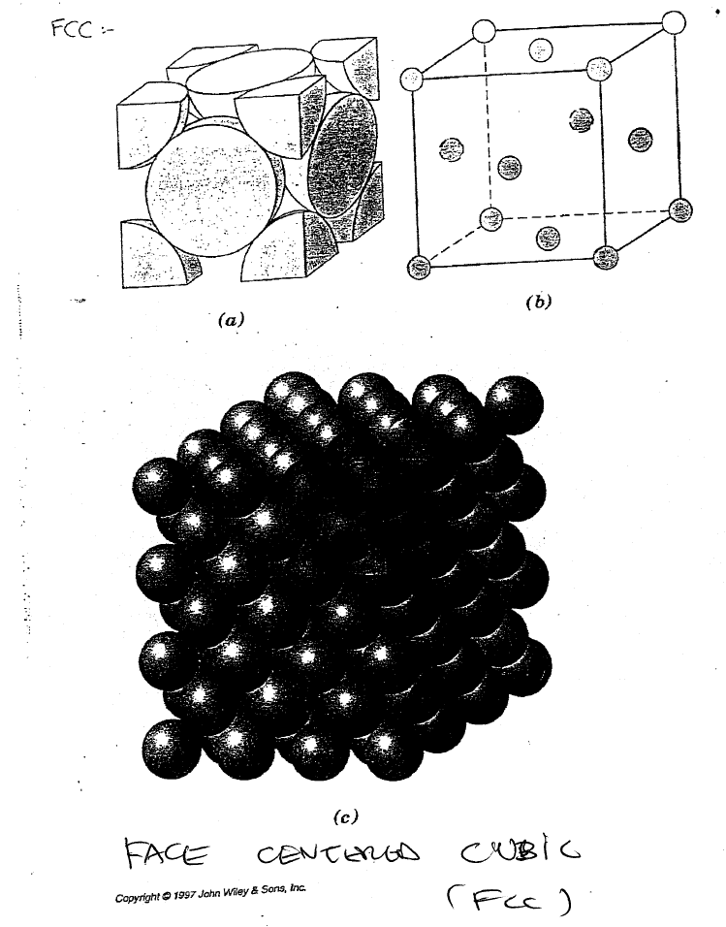

Slide 11
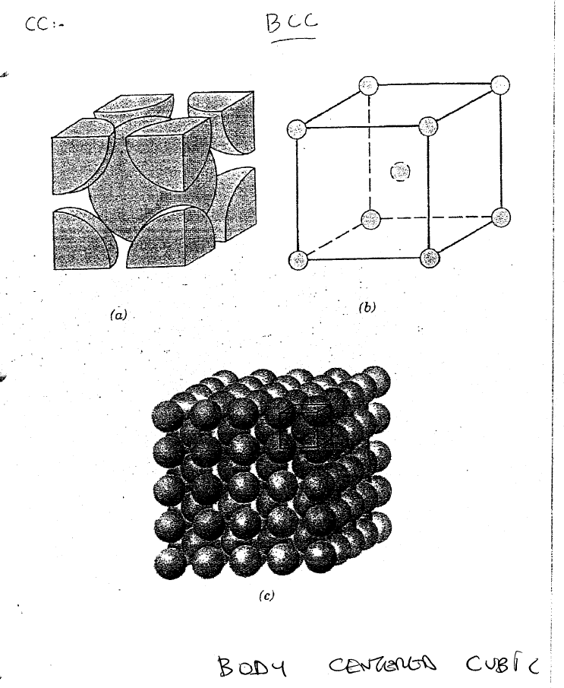

Slide 12
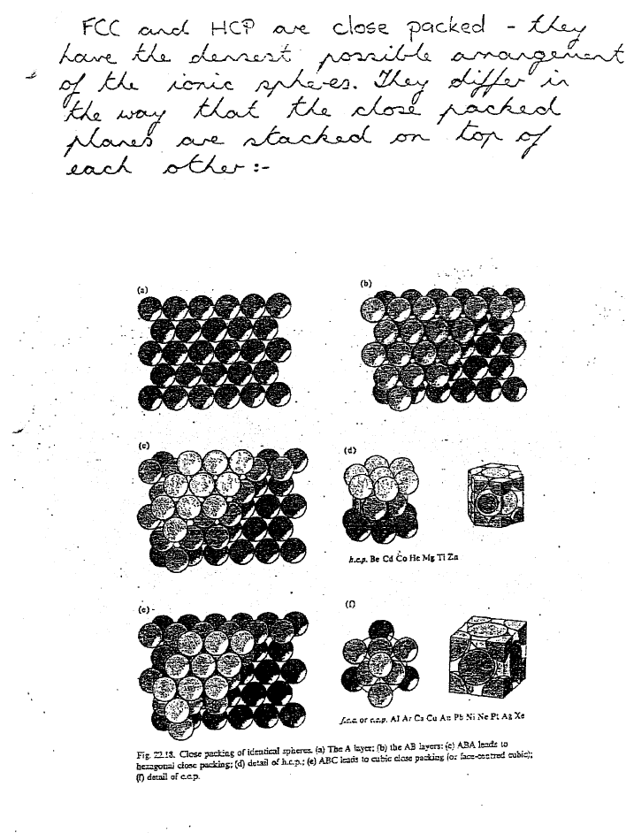

Slide 13
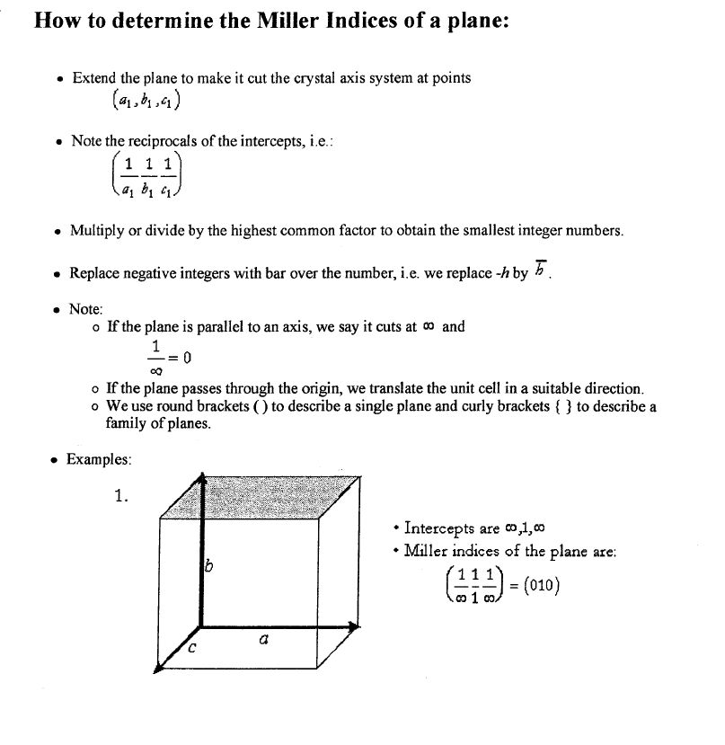
Miller Indices

Slide 14
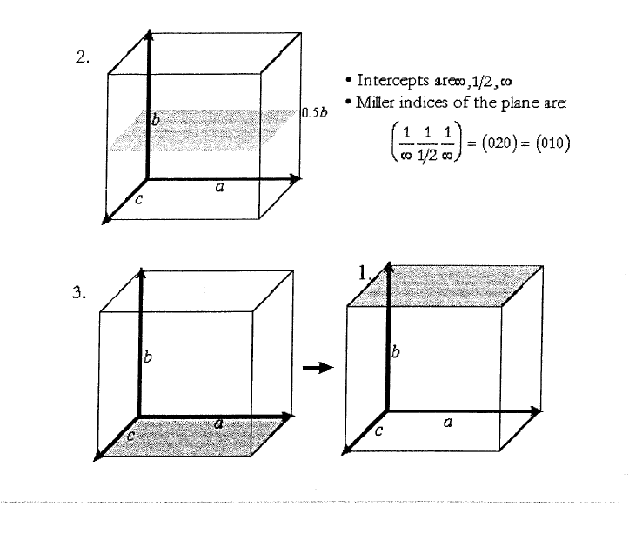

Slide 15
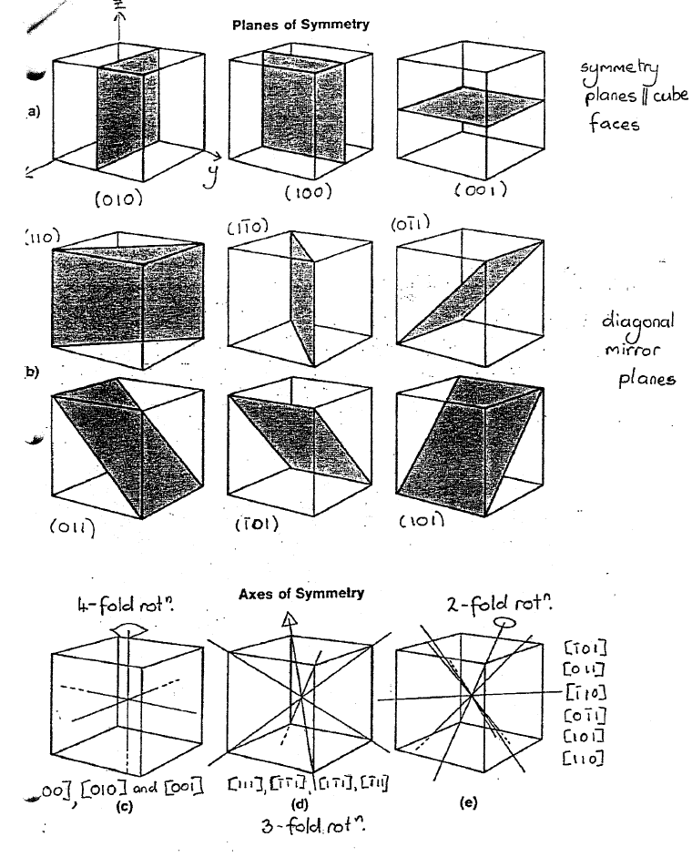
Crystal Symmetry

Slide 16
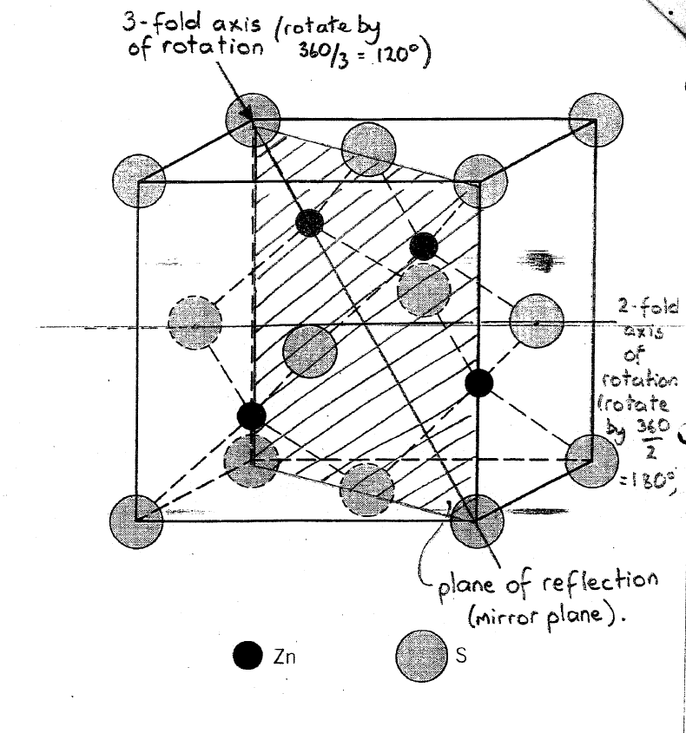

Slide 17
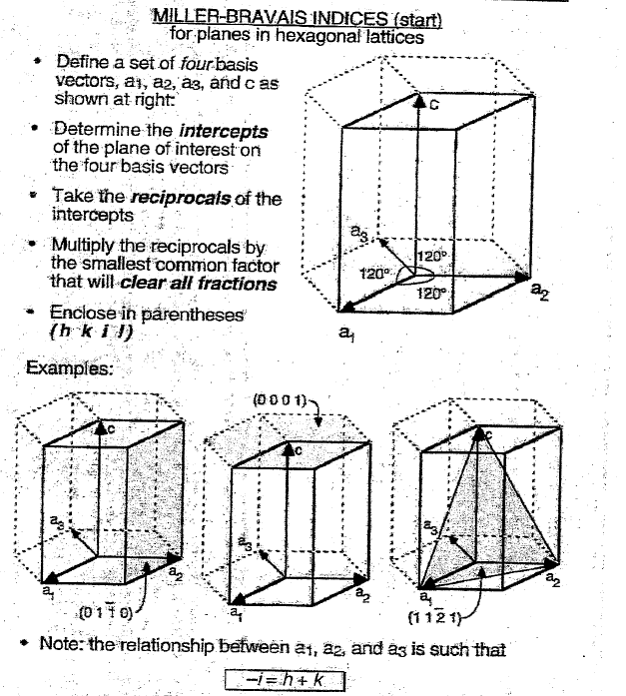

Slide 18
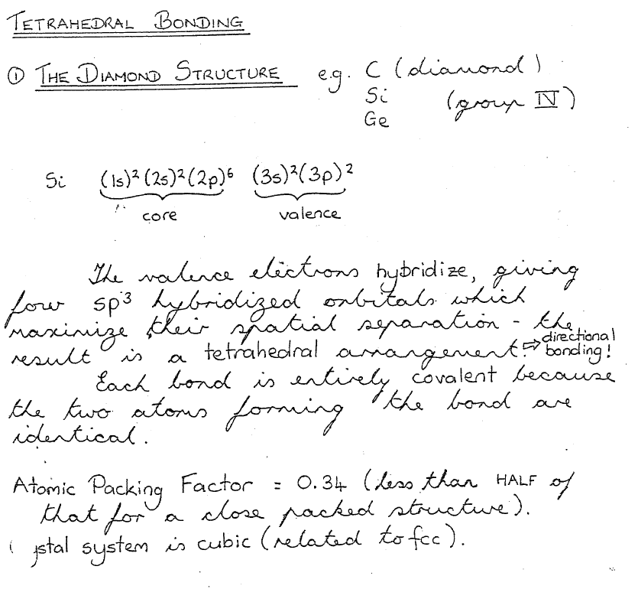
Crystal Structures-Bonding

Slide 19
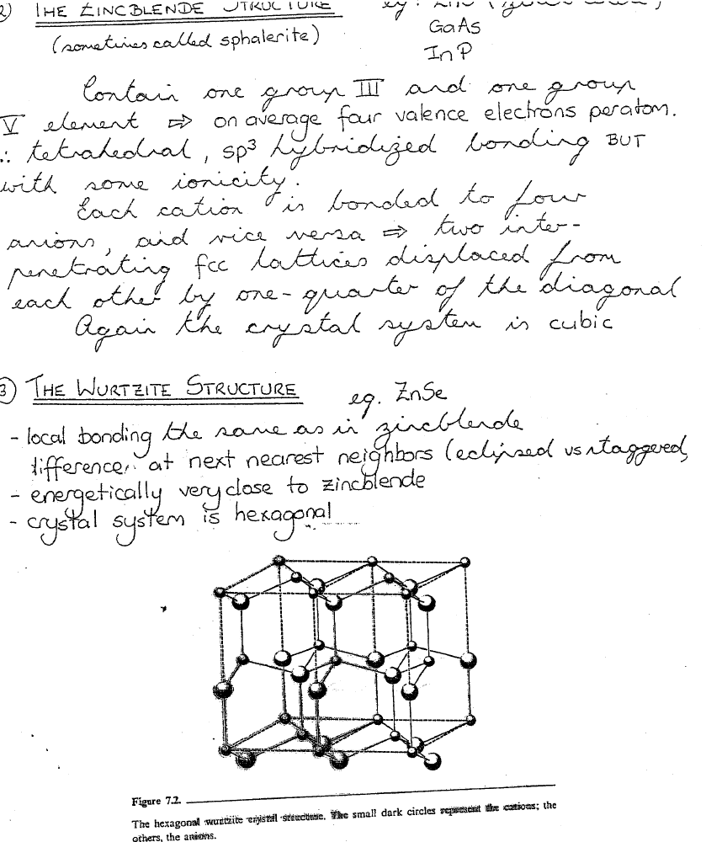
Crystal Structures-Bonding

Slide 20
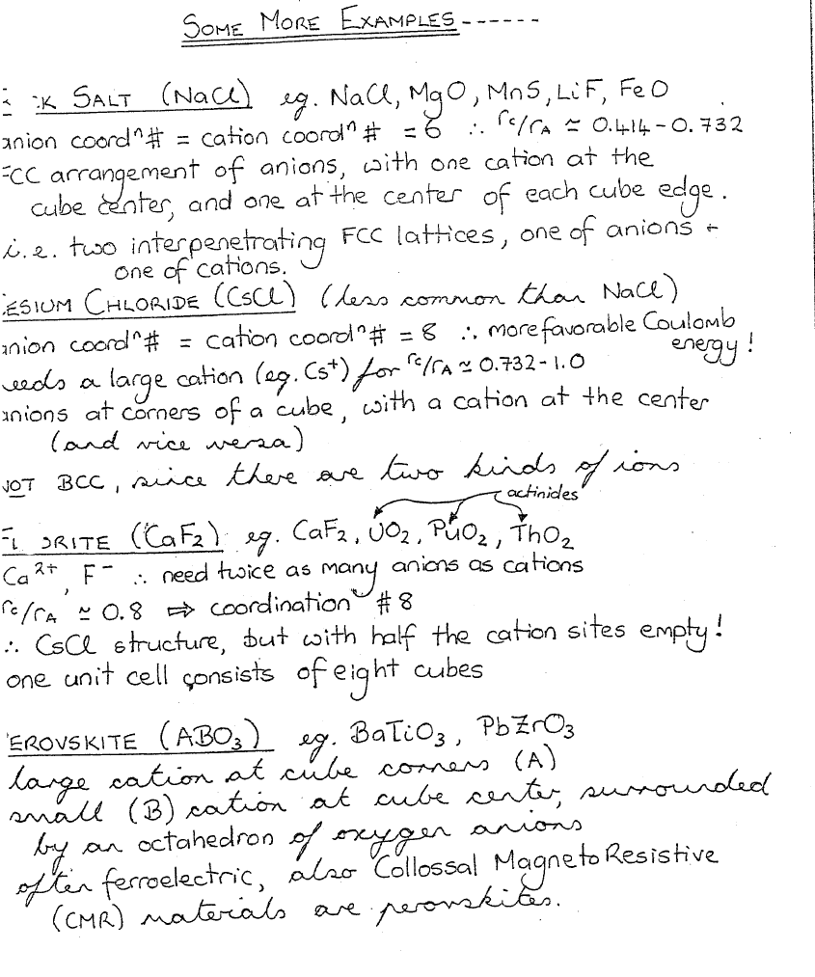

Slide 21
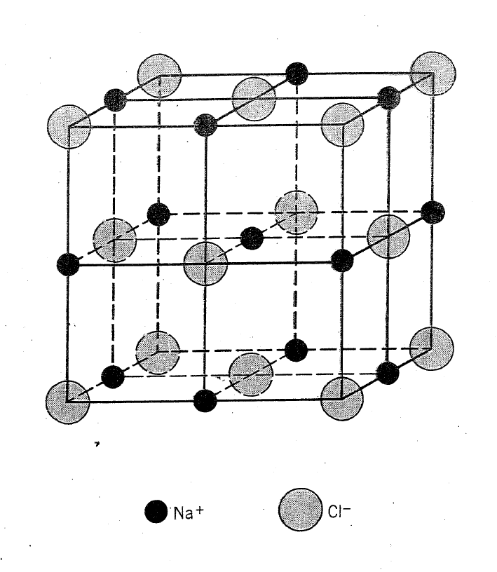
Rocksalt (NaCl)

